Slide 1
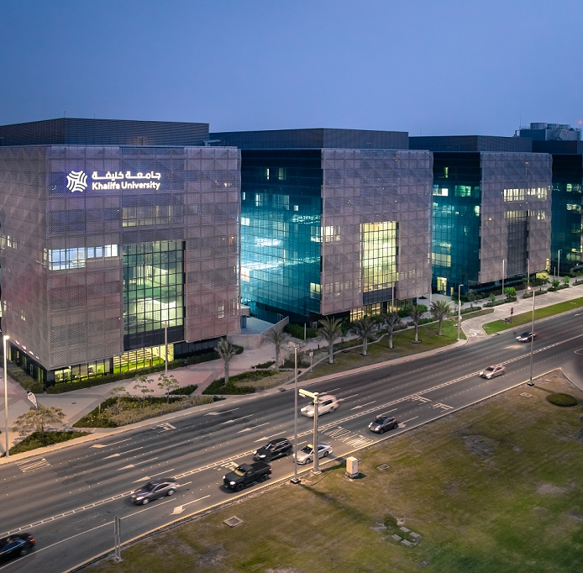
Business Projects Updates

Slide 2
Business Performance 2022
66,229,000
Budget
44,607,000
Actuals Accrual Basis
62,221,620
Actuals Cash

Slide 3
Main Revenue Sectors
Facilities
Academic
Investment
- Spaces Rental
- Laboratories Services
- Dorms
- Transportation
- Scholarship (Tuition)
- Sponsorship
- Continuing Education Center
Techno-Park
Endowment
KUEC

Slide 4
Facilities
Laboratories Services
Venue Rental
Outlet Rental
Sports Area
Dorms
Transportation
Outdoor Screen
Student Card

Slide 5
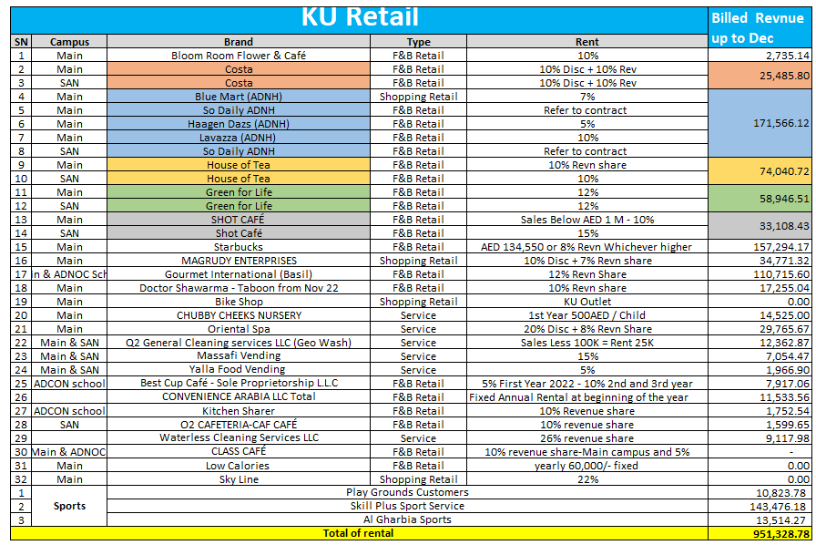

Slide 6






KU Laboratories Commercialization Progress Report
Activity | 1 | 2 | 3 | 4 | 5 | 6
Activity | Collect data of all KU Labs | Pricing of KU Lab Services | Lab Access and Utilization Policies and Procedures | Preparation of Labs Website or Portal | Start Trial Operation | Provide Services through a “KU Services Company” which can conduct commercial business
Status / Timeline | Done | Done | Sep 2021 | Oct 2021 | Nov 2021 | Sep-Dec 2021
Description | Process of collecting KU labs data from all academic and research departments. Classify labs groups and assets against services that can be provided. | Benchmark the services and prices with similar labs in international universities Pricing of KU lab services into two groups: Usage KU labs only Using KU labs with KU staff support | Preparation of the lab usage policies and procedures, processes, workflow, and documentation | Listing all the ready laboratories on KU website with prices | Start trial operation to make sure that usage policies and procedures well known by all parties. Make sure that lab usage do not interrupt KU academic process or research. | Establish Khalifa University Services as an LLC Company registered with DED (process to include governance framework, etc.) to handle the lab usage business.

Slide 7
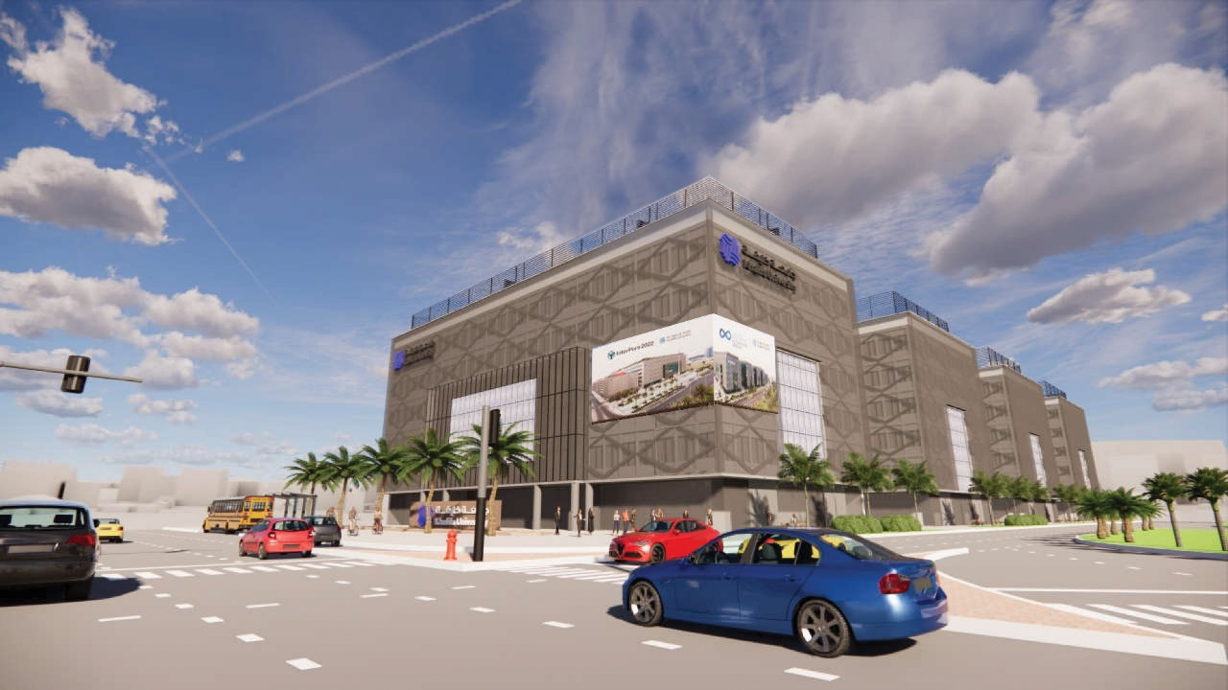
Commercial activities
Project Name: Outdoor Advertisement Screens
Project involved departments: Communications /Project time frame: 6 months.
Project briefing: to install huge outdoor screen to help in community awareness and generate revenue.
Project Timeframe: Jun 2023
Pending points: to meet our management to approve the concept.

Slide 8
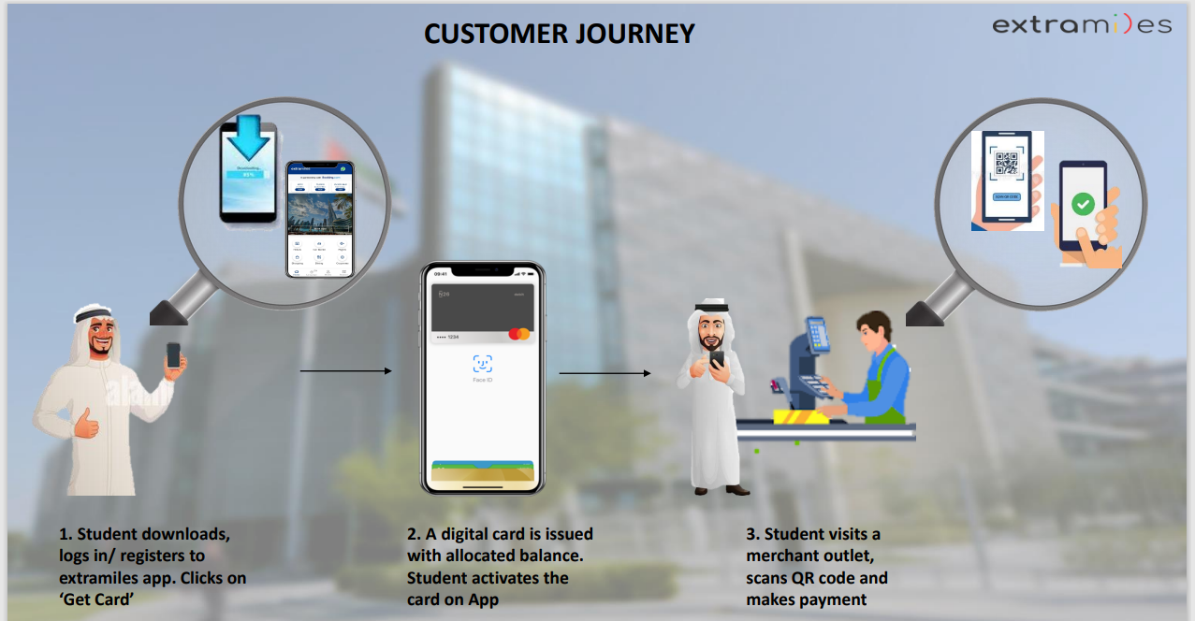

Slide 9
Academic
Scholarship (Tuition)
Sponsorship
Continuing Education

Slide 10
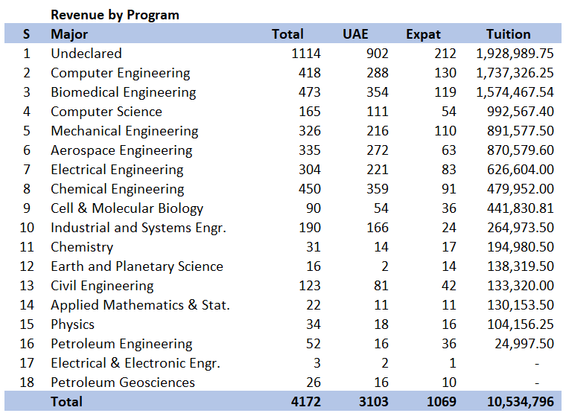

Slide 11
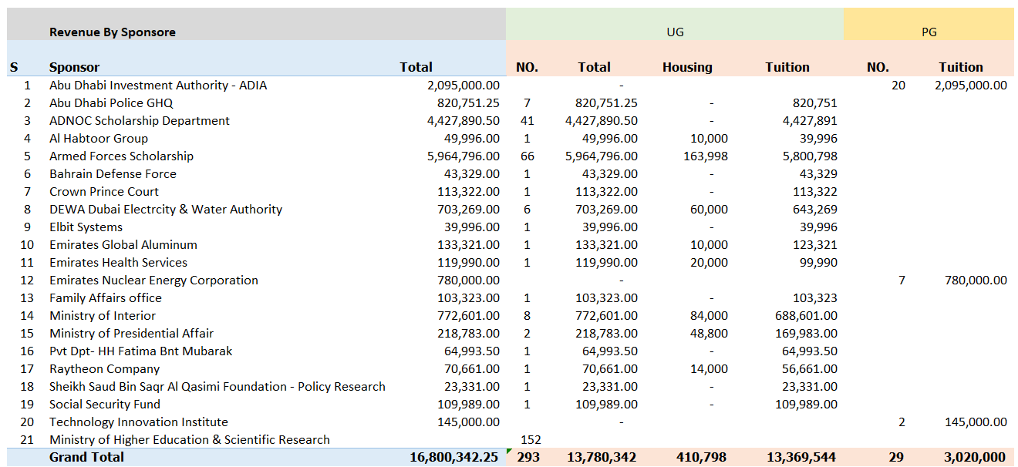

Slide 12
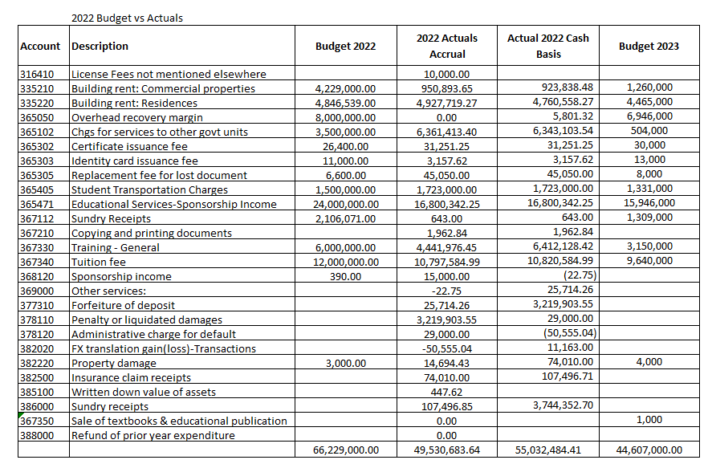

Slide 13
Investment
Techno-Park
KUEC
Endowment

Slide 14
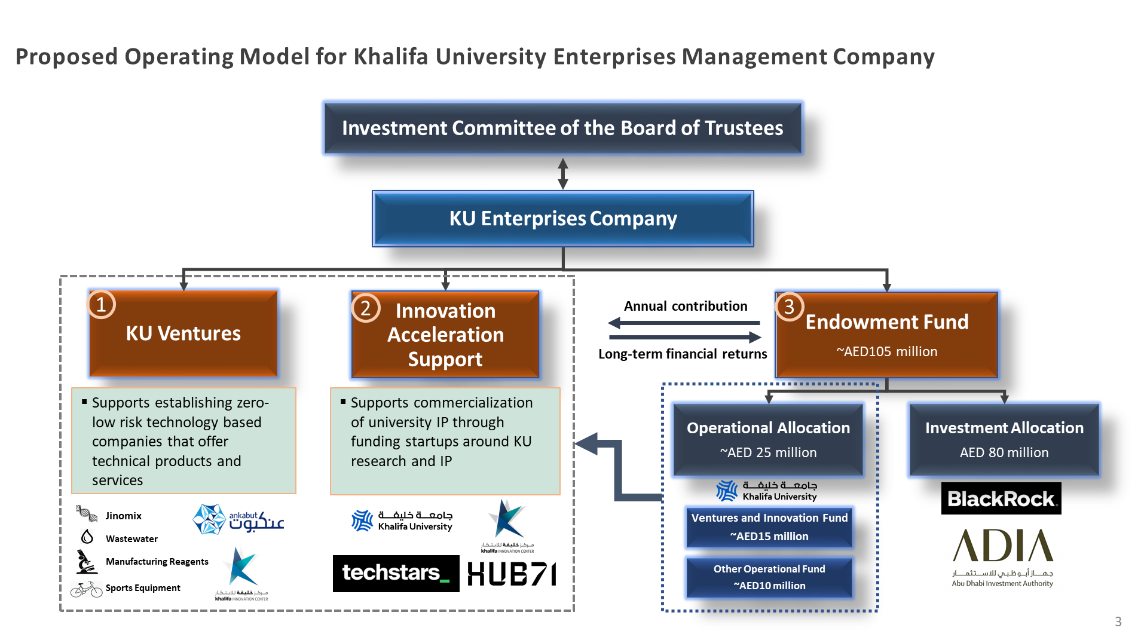

Slide 15





KU Ventures support establishing zero/low risk technology based companies that offer technical products and services.
1. KU Ventures
Technology Companies
Operational Assets
Advisory Services
Jinomix
Wastewater
Transfer Ankabut stake from KU to the Enterprise Management Company
Operate Ankabut as a standalone commercial entity with its own Finance, HR, Marketing, & Procurement divisions, to unlock business opportunities (expanding beyond education sector and beyond UAE)
Provide advisory and consultancy services to the community, using high profile and experience of university faculties and staff in different scientific and technical areas of need and impact to UAE.
Manufacturing of RNA Extraction Reagents
Sports Equipment
Manufacturing Company

Slide 16

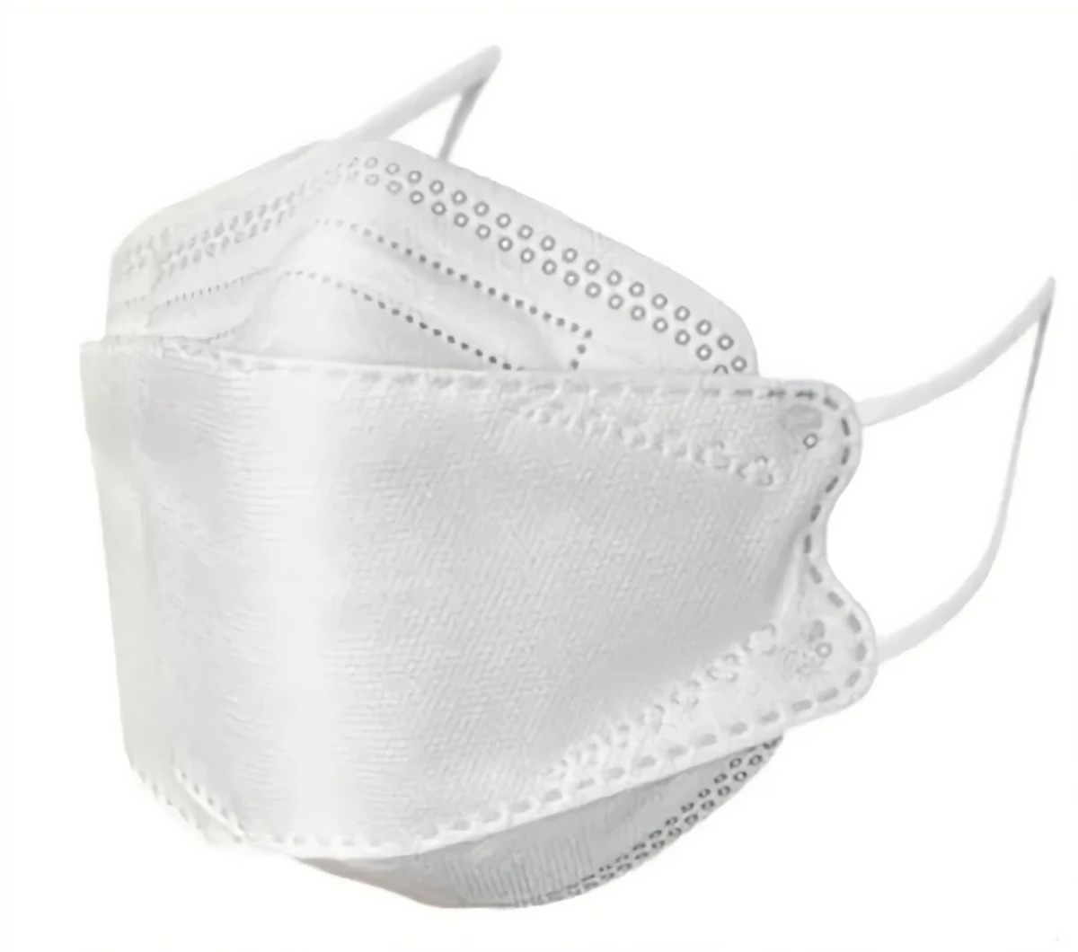





KUEC projects status
S |  | Project Name | Project Activity | Project Set Up | Project Assets | Project Production | Funding | Required Funding | Business Plan | Licensing Need | Licensing Priority
1 |  | Ankabut | IT services and solutions | Ready | Ankabut Assets | Operating | Self Funding | Under Progress | Under Progress | Yes | Stge 1
2 |  | NAVA Mask | High quality mask | Ready | Outsourced Supplier | Outsourced Production | No Funding | .5-1 M | Under Progress | Can Operate under Baynounah | Stage 1
3 |  | Water Intelligence Testing Center | Water analysis for detecting diseases, pollution and toxics | Ready | KU Lab | Operating | No Funding | 2-3 M | Yes | Yes | Stage 2
4 |  | KU Bike | Manufacturing bikes and sports equipment | Ready | KU Lab | Operating | No Funding | 2.5-3.5 M | Yes | Yes | Stage 2
5 |  | Baynounah | Extraction Reagents | Ready | KU Lab | Operating | Self Funding at Beginning | 2-3 M | Yes | Yes | Stage 1
6 |  | Jinomix | DNA & RNA analysis | Ready | KU Lab | Operating (currently on hold) | No Funding | 2-3 M | Yes | Yes | Stage 2
7 |  | KU Services Company | Laboratories and spaces rental & Advisory Service | Ready | KU Facilities | Ready for Operation | No Funding | .5-1 M | Under Progress | Yes | Stage 1
8 |  | Rassed | Covid19 detection instrument | Under Progress | Under Progress | Under Progress | No Funding | .5-1 M | Under Progress | Can Operate under Baynounah | Stage 1
9 |  | KIC | Startups and Innovation Investments | Ready | KU Facilities | Operating | Self Funding | NA | Under Progress | NA | NA
.

